Slide 1
bitbucket

Slide 2

Bitbucket
Overview
Bitbucket is a web-based hosting solution for projects that use either the Mercurial or Git revision control systems. Developed for professional teams, BitBucket enables users to code, manage, and collaborate on Git projects.
BitBucket provides tons of benefits for professional developers and code workers. It comes with a distributed control system that allows easy collaboration and massive scaling. It can be deployed according to the needs and sizes of teams and users have the option to host it on their servers or in the cloud. BitBucket also boasts unlimited private and public repositories.

Slide 3
Bitbucket
The need of online collaborative work.
Track your change sets, monitor your source code edits, and drill through to your source files.
It’s worth having a back-up.
The quicker you make your code publicly available, the quicker you gain feedback and people to help you.
Getting feedback of users and interested developers who might want to join your team, provide helpful idea and move this project forward.

Slide 4

Bitbucket
Repository
It refers to a storage location, often for safety or preservation.
A repository contains all of the project files (including documentation), and stores each file’s revision history.
Repositories can have multiple collaborators and can either be public or private.

Slide 5
Bitbucket
Fork
A fork is a personal copy of another user’s repository that lives on your account. Forks allow you to freely make changes to a project without affecting the original.
Forks remain attached to the original, allowing you to submit a pull request to the original’s author to update with your changes.

Slide 6
Bitbucket
Clone
A clone is a copy of a repository that lives on your computer instead of on a website’s server somewhere, or the act of making that copy.
With your clone you can edit the files in your preferred editor and use Git to keep track of your changes without having to be online.

Slide 7
Bitbucket
Push
Pushing refers to sending your committed changes to a remote repository such as Bitbucket.
For instance, if you change something locally, you’d want to then push those changes so that others may access them.

Slide 8
Bitbucket
Pull
Pull refers to when you are fetching in changes and merging them.
For instance, if someone has edited the remote file you’re both working on, you’ll want to pull in those changes to your local copy so that it’s up to date.

Slide 9
Bitbucket
Commit
A commit, or “revision”, is an individual change to a file (or sets of files ). It’s like when you save a file, except with Git, every time you save it creates a unique ID that allows you keep record of what changes were made when and by who.
Commits usually contain a commit message which is a brief description of what changes were made.

Slide 10
Bitbucket
Fetch
Fetching refers to getting the latest changes from online repository without merging them in.
Once these changes are fetched you can compare them to your local branches (the code residing on your local machine).

Slide 11
Bitbucket
BENEFITS
It’s worth having a backup.
Git has proven to be effective for projects with hundreds and even thousands of contributors.
Avoid parallel code conflicts and overwriting of each others’ work.

Slide 12
Bitbucket
FEATURES
PULL REQUESTS
- Pull requests facilitate code reviews, resulting in higher quality code and an opportunity to share knowledge amongst your team.
BRANCH PERMISSIONS
-Branch permissions provide granular access control for your team, ensuring the right people can make the right changes to your code.
CODE AWARE SEARCH
-Save time combing through usage results with a semantic search that ranks definitions first.

Slide 13
Bitbucket
FEATURES
DIFF VIEWS
- Understand what's changing in your repositories with unified or side-by-side diffs when reviewing code.
PROJECTS
-Help your team focus on a goal, product or process by organizing your repositories into projects.
BUILD INTEGRATION
-Bitbucket can show build results from your CI system. A simple pass or fail icon tells you about the health of your code.

Slide 14
Bitbucket
FEATURES
JIRA SOFTWARE INTEGRATION
- Create a branch from within a Jira Software issue and set up triggers to transition between statuses when reviewing or merging code.
3RD PARTY INTEGRATIONS
-Integrate into your existing workflow to streamline your development process.
DESKTOP CLIENT
-Harness the full power of Git and Mercurial in a beautifully simple desktop application.

Slide 15
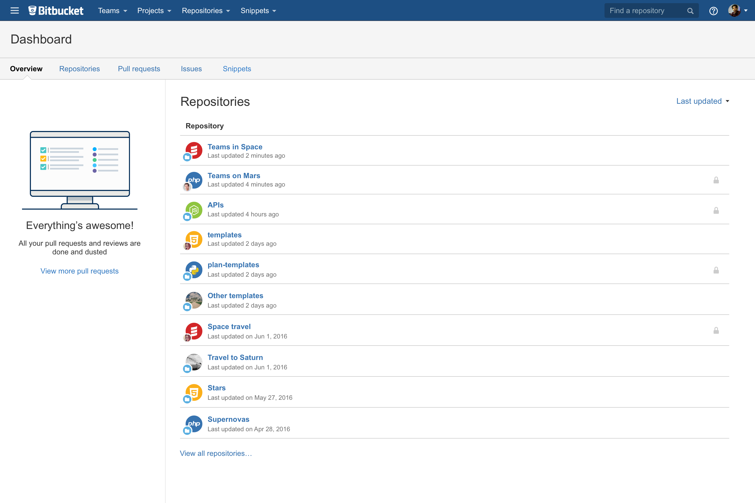
BITBUCKET
Project Dashboard

Slide 16
BITBUCKET
References
https://bitbucket.org/
https://bitbucket.org/product/features

